Slide 1

Advanced Programming
Assessor name: TRUNG-VIET NGUYEN
Student Name: PHAM CAO NGUYEN
Class: GCC0801
Student ID: GCC18074

Slide 2
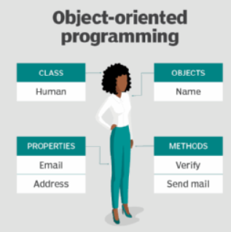
Part 1. Examine the key components related to the object-orientated programming paradigm, analyzing design pattern types.
Examine the characteristics of the object-orientated paradigm as well as the various class relationships.

Slide 3
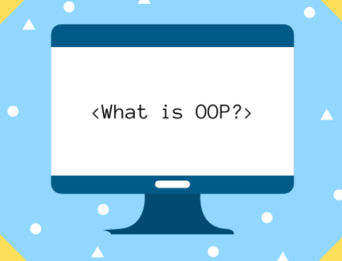
1. What is object-oriented programming?
Object-Oriented Programming refers to the programming paradigm based on the concept of objects. It can also contain data in the form of different fields and these fields are known as properties or attributes. It also includes code in the form of procedures, which are known as methods.

Slide 4
2. Advantages and Disadvantages
Advantages
OOP provides ease of operation due to its modularity and encapsulation.
OOP mimics the real world, which makes things easy to comprehend.
Since objects are whole within themselves, they can be reused in other programs.

Slide 5
Disadvantages
Object-oriented programs appear to be sluggish and have a large memory consumption.
Overexploitation.
Programs constructed using this model can take more time to build.

Slide 6
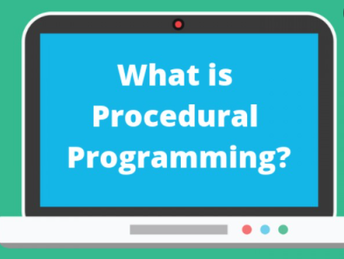
3. Procedural-oriented Programming
Procedural programming languages are also imperative languages because they make explicit references to the state of the execution environment. This could be anything from variables (which may correspond to processor registers) to something like the position of the "turtle" in the Logo programming language.

Slide 7
4. Advantages and Disadvantages
Advantages
Procedural-oriented programming is great for strategic planning.
Written flexibility together with ease of compiler and interpreter implementation.
A broad range of books and online training content based on validated algorithms to make learning simpler along the way.
The source code is adaptive, since a certain Processor may also be exploited.
The algorithm can be reused in certain areas of the program, without the need to copy it.
The memory level also slashes through the technique of Procedural Programming.
Effective analysis of the program flow.

Slide 8
Disadvantages
The program code is harder to write when Procedural Programming is employed.
The Code of Procedure is also not reusable, which might necessitate the reconstruction of the code if it is used in another application.
Difficult to relate to real-world objects.
The importance is given to the operation rather than the data, which might pose issues in some data-sensitive cases.
The data is revealed to the whole software and does not render it secure.

Slide 9
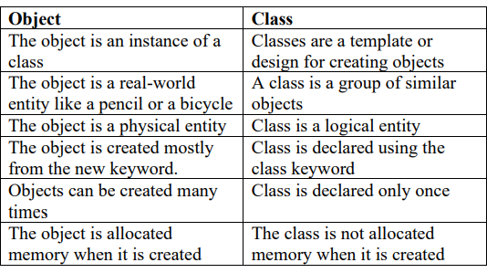
5. Relationship of Objects and Classes
Objects: An object is an instance of a class that collects data and procedures for manipulating data.
Classes: A class defines the properties of objects linked to it.

Slide 10
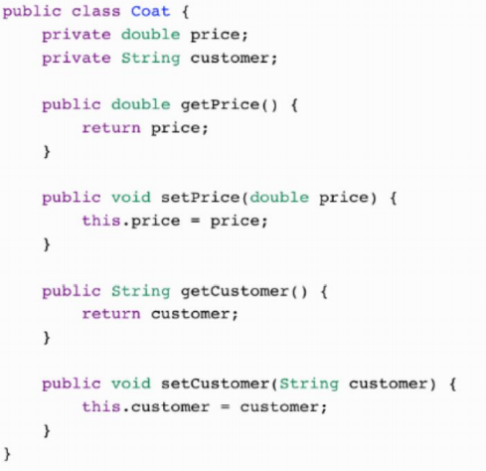
6. Encapsulation
“The process of arranging one or more things into a physical or logical container” is how encapsulation is defined. In object-oriented programming theory, encapsulation restricts access to implementation knowledge.

Slide 11

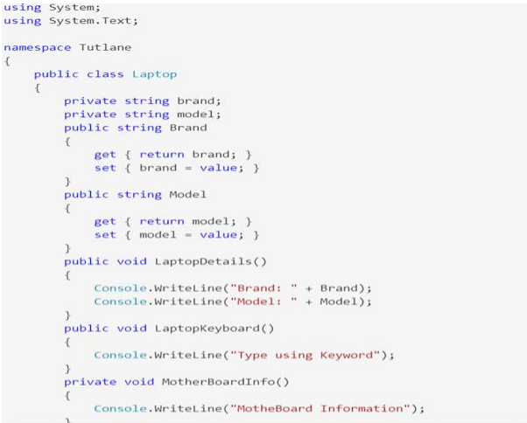
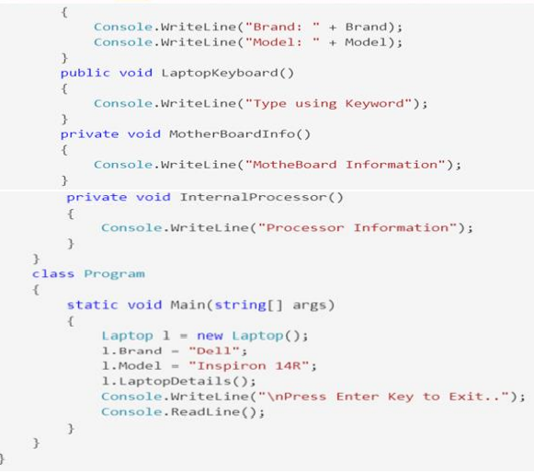
7. Abstraction
Abstract classes and interfaces are used to hide the internal details and show the functionality.

Slide 12
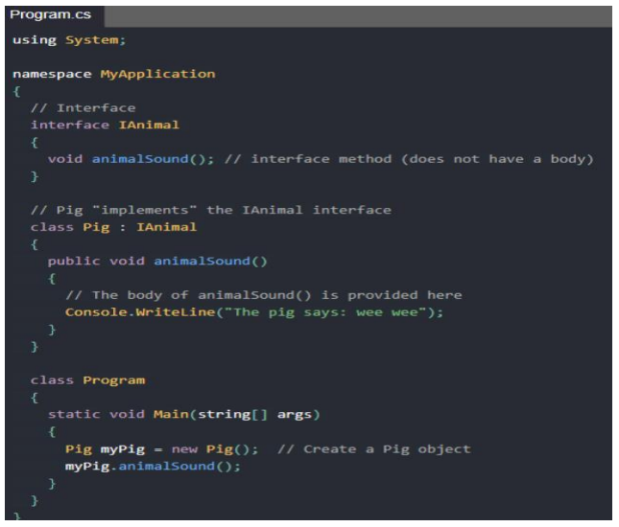

8. Interface
An abstract base class with just abstract members is generally used for the interface. All members of an interface must be enforced by each class or structure that implements it. The interface can optionally define default implementations for any or all of its elements.

Slide 13
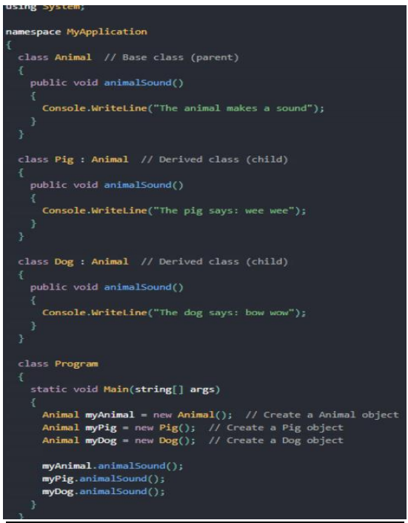
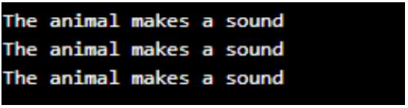
9. Polymorphism
Polymorphism is the capacity to act in a variety of ways depending on the situation. It is most commonly encountered in applications where many methods with the same name but distinct parameters and behavior are specified.

Slide 14
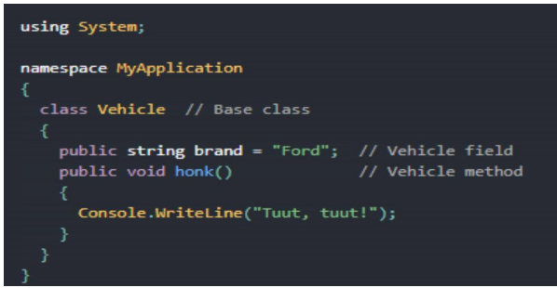
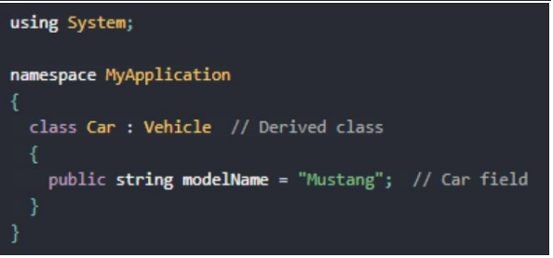
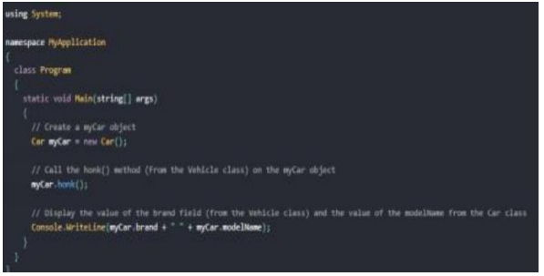

10. Inheritance
The act of generating a new class based on the attributes and methods of an existing class is known as inheritance. The current class is referred to as the base class, while the newly generated class is referred to as the derived class. This is a crucial notion in object-oriented programming because it allows inherited properties and functions to be reused.

Slide 15
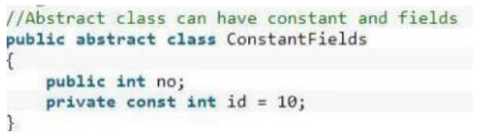
11. Abstract class
The abstract adjustment indicates that the item being modified is absent or incompletely implemented. Classes, processes, properties, indexers, and events can all benefit from abstract modifiers. Use an abstract changer in a class declaration to indicate that a class is intended to be a base class for other classes rather than a standalone object. Members marked as abstract must perform non-abstract classes derived from abstract classes.

Slide 16
Part 2: Design a series of UML class diagrams
II. Design and build class diagrams using a UML tool.
Project Specification: FPT is an international academy and now they want to create an application to store the list of students, faculty, employees, customers, and show the main menu. I perform the segment of managing to in student management system. My team and I will program and develop the student management system for FPT International Academy, and I am the team leader. An application should be designed to show all the students of the school. And display details about student information such as phone number, address, email, DoB...with functions such as search, adding, editing, and deleting customer and employee information as well as students and lecturers. May view all as ID, Name, Phone, Mail, Address.

Slide 17
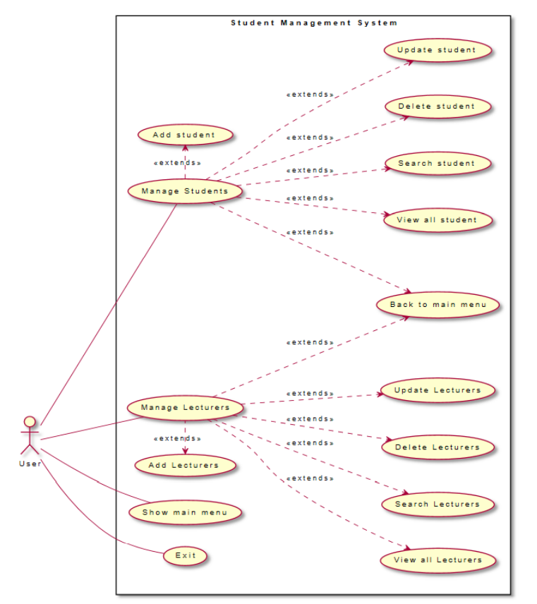
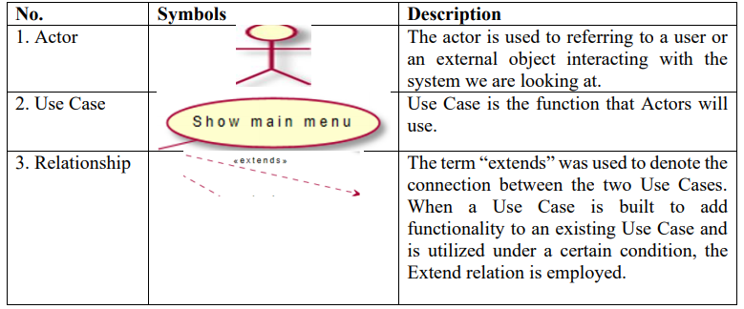
1. Use-case diagram.
Use case diagram includes:
Manage Students, Manage Lecturers.
Use-case diagram’s notation table.

Slide 18
2. Class diagram.
The class diagram includes the following properties: Person, student, program, lecturer. in the Person, section include ID, Name, DoB, Email, Address. Properties in Person will be set in lecturer and student. IPerson interface has InputForm (), Validate () methods used to check ID, DisplayInfor () The abstract Person class extends the IPerson interface to implement methods. It is also a class inherited by the Student and Instructor classes to add information such as ID, Name, Email, Address, DoB. Teacher class has a Division property and a student class has a Batch property, they work similarly

Slide 19
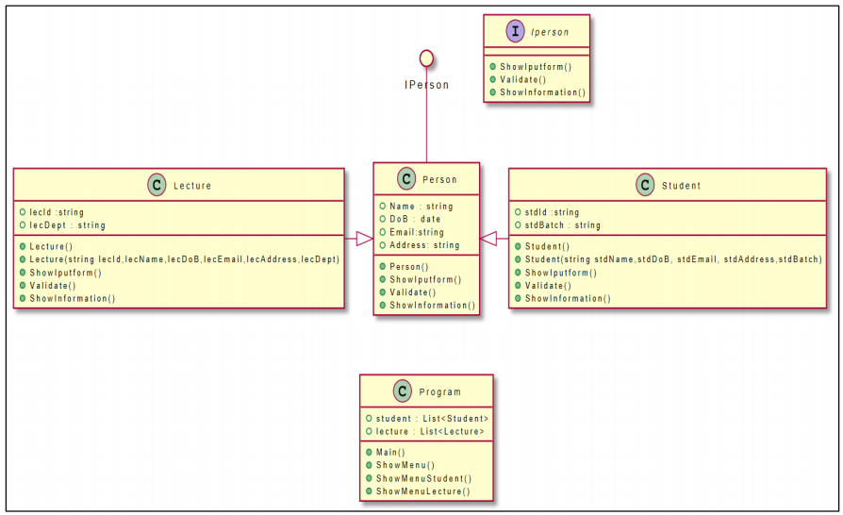
Class diagram

Slide 20
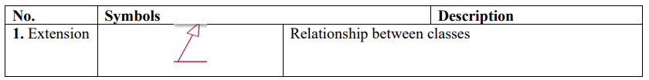
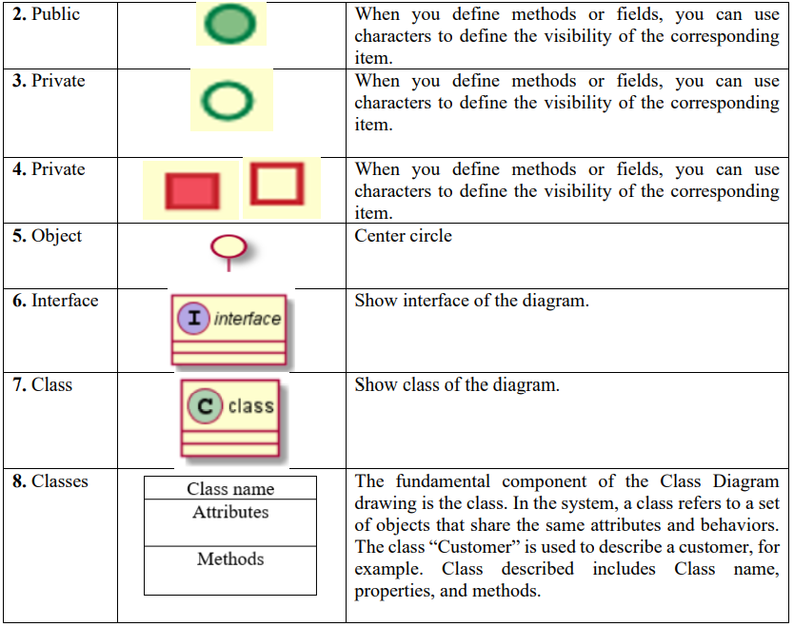
Class diagram’s notation table.

Slide 21
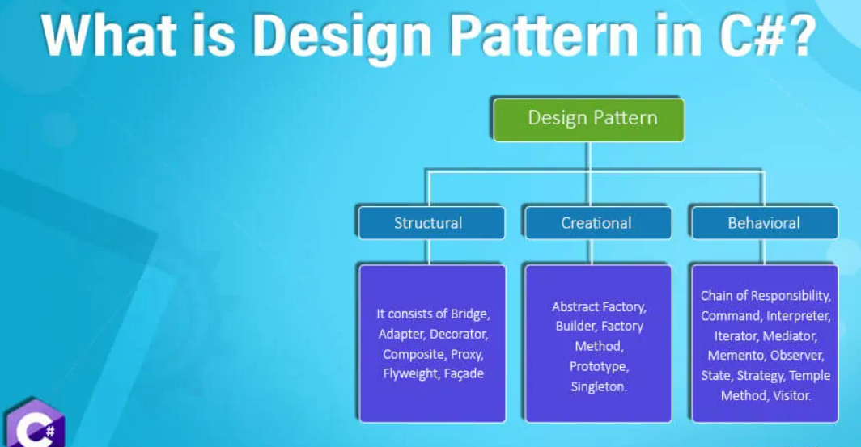
3. What are Design Patterns?
Design Patterns are models of code that solve classic problems. They are solutions to software design problems that you can find in a real-world application. A Design Pattern is not a code that is ready to be used in your application, but it is a model that you can use to solve a problem.

Slide 22
4. Introduction to Creational Design Patterns.
Introduce
In software engineering, Design Patterns describe building solutions to the most common problems in software design. It represents best practices developed over a long period of time through trial and error by experienced developers.
In this article, we will learn about creational design patterns and their types. We’ll also look at a few examples and discuss the conditions under which design patterns are suitable for design.

Slide 23
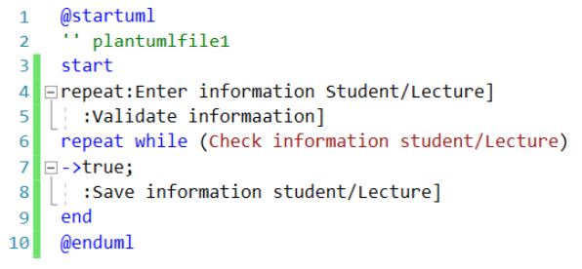
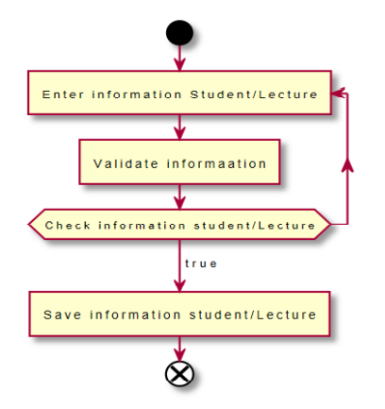
5. Activity Diagram
Add Information Student/ Lecture

Slide 24
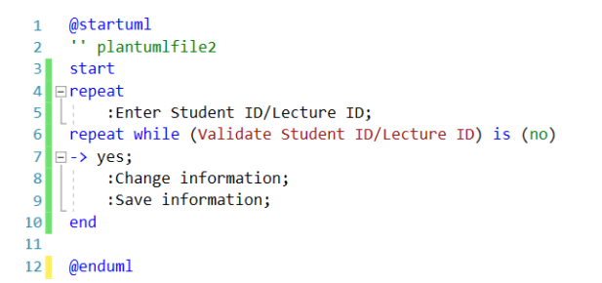
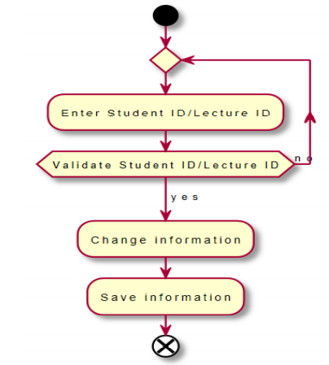
Update information Student/Lecture

Slide 25
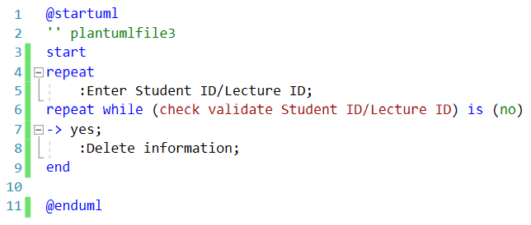
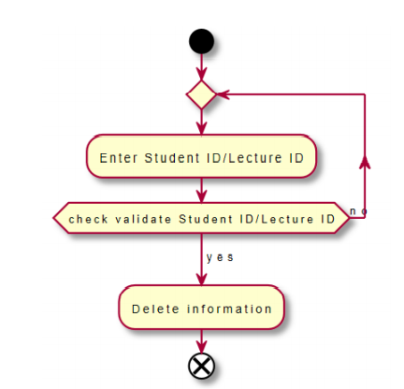
Delete Student/Lecture

Slide 26
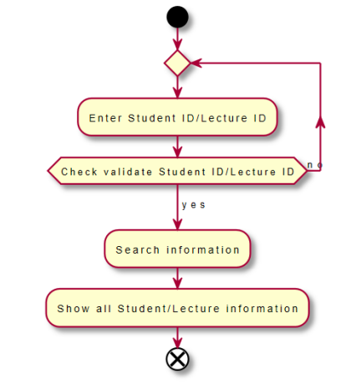
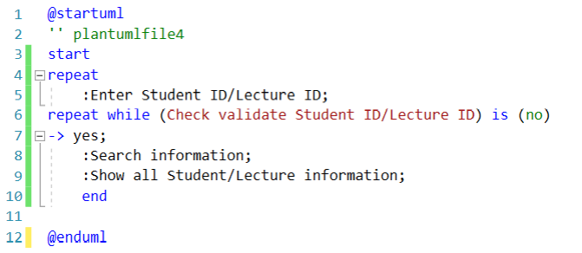
Search information Student/Lecture

Slide 27
----THE END----
--Thank you to everyone who listened to the report--

